Slide 1

TUMOR DETECTION USING DIGITAL IMAGE PROCESSING
Submitted by:
SRINIVAS KASTURI (3078674)
DEC 20,2016

Slide 2
PROJECT IDEA
Each year more than 200,000 people in every country are diagnosed with a primary or metastatic brain tumor.
The chances of surviving for a person with a brain tumor greatly depends on all of the following:
Type of tumor
Size of the extent
Location of the tumor
Presence or absence of metastasis

Slide 3
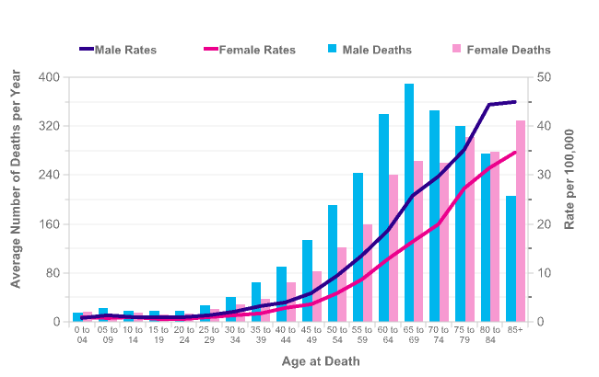


Slide 4

AUTHORS AND PROFESSORS
1) S. Murugavalli, V. Rajamani, “A high speed parallel fuzzy c-mean algorithm for brain tumour segmentation”,” BIME Journal.
2) Mohamed Lamine Toure, “Advanced Algorithm for Brain Segmentation using Fuzzy to Localize Cancer and Epilepsy Region”.
3) Dr.G.Padmavathi, Mr.M.Muthukumar and Mr. Suresh Kumar Thakur, “Non linear Image segmentation using fuzzy c means clustering method with thresholding for underwater images”.
4) W. Gonzalez, “Digital Image Processing”.

Slide 5
CONTENTS
OBJECTIVE
INTRODUCTION
METHODOLOGY
RESULTS
ADVANTAGES
CONCLUSION
FUTURE SCOPE

Slide 6
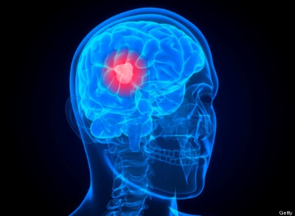
OBJECTIVE
To detect the tumor and location of brain tumors from the Magnetic Resonance Images using Digital Image Processing.

Slide 7
INTRODUCTION
Brain tumor is an abnormal mass of tissue in which cells grow and multiply uncontrollably seemingly unchecked by the mechanisms that control normal cells.
Brain tumor can primary and metastatic, also can be benign or malignant.
Primary brain tumors include any tumor that start within the brain also it affect the membrane around the brain, nerves or glands.
To identify a tumor a patient has to undergo several test but the commonly used test include CT scan, MRI scan, PET scan etc.

Slide 8
Conti….intro
MRI is used to locate or visualize internal structure of the body in detail. From this detailed anatomical information is collected to examine the human brain development and discover the abnormalities.
Many different kinds of imaging techniques are used in de-noising and visualizing the structure but now a days for classifying the MRI brain images techniques used are-fuzzy logic, neural network, knowledge based methods, variation segmentation
Thresholding is the simplest technique of image segmentation which is used to create binary images from grayscale images, morphological operation is used to check and determine the size and shape of tumor whereas image subtraction is applied to extract tumor region.

Slide 9
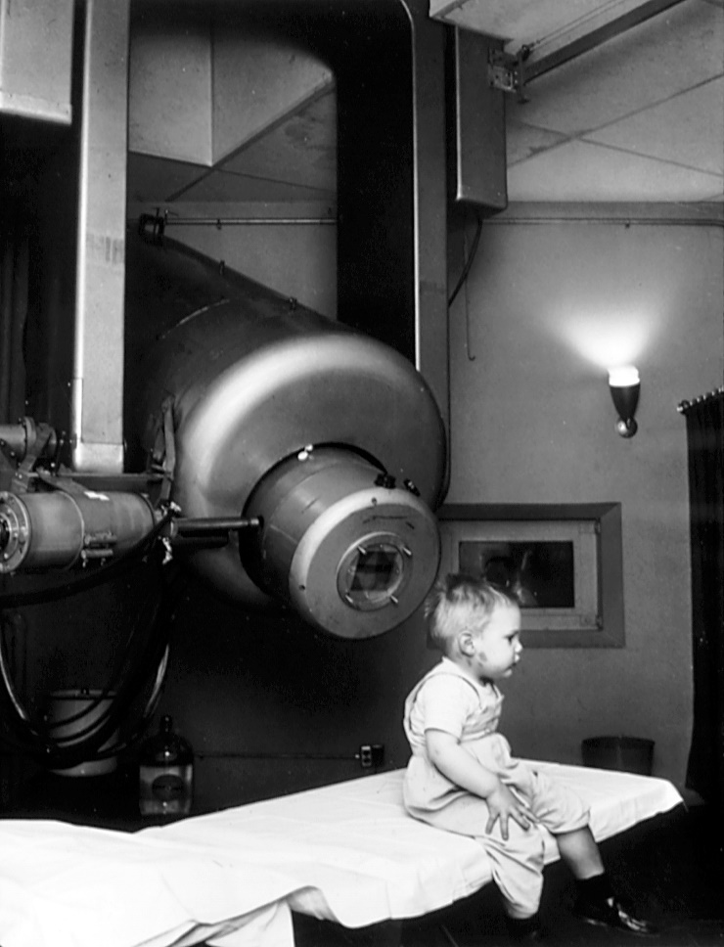
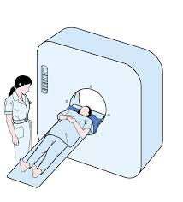
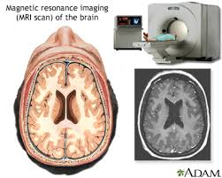
MRI/ CT scan
Fig-www.tumorsegmentation.org,www.radiopedia.org

Slide 10
MRI
How does it work?
The body is largely composed of water molecules.
Each water molecule has two hydrogen nuclei or protons
A powerful magnetic field causes the magnetic moments of some of these protons to align with the direction of the field.
The protons in different tissues return to their equilibrium state at different rates
Diffusion MRI, Fluid Attenuated Inversion Recovery (FLAIR), Susceptibility weighted imaging (SWI).

Slide 11
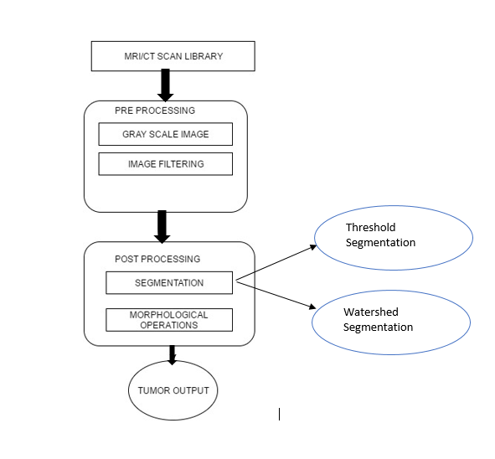
Workflow/Methodology

Slide 12
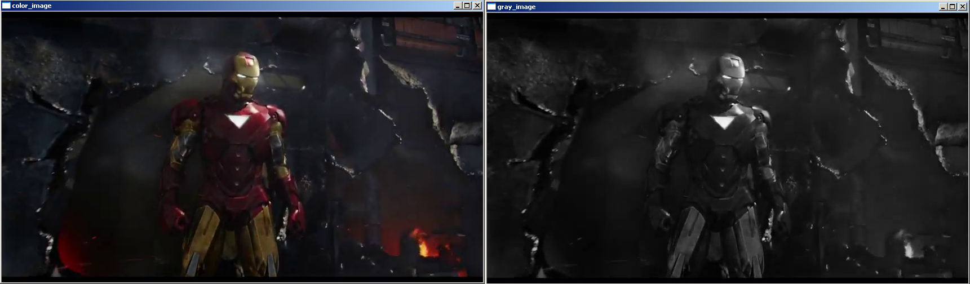
Grayscale Imaging
Gray scale imaging is called as black and white image and it can also be called as halftone image so obtained by considering the images as a grid of black dots on white background.
Also because there are 8 bits in binary representation of the gray level , so this method is also called 8-bitgrayscale.also it can be used in the preprocessing step of image segmentation to improve upon the contrasted image

Slide 13
Histogram Equalization
Histogram are constructed by splitting the range of the data into equal-sized bins (called classes). Then for each bin, the number of points from the data set that fall into each bin are counted.
Vertical axis: Frequency (i.e., counts for each bin)
Horizontal axis: Response variable.
In image histograms the pixels form the horizontal axis
In Matlab histograms for images can be constructed using the imhist command.
Histogram equalization is a gray level transformation that results in an image may have a flat or peaked histogram.by this global contrast histogram of the image scan be improved. Also it accomplishes this by spreading out the most frequent intensity values

Slide 14
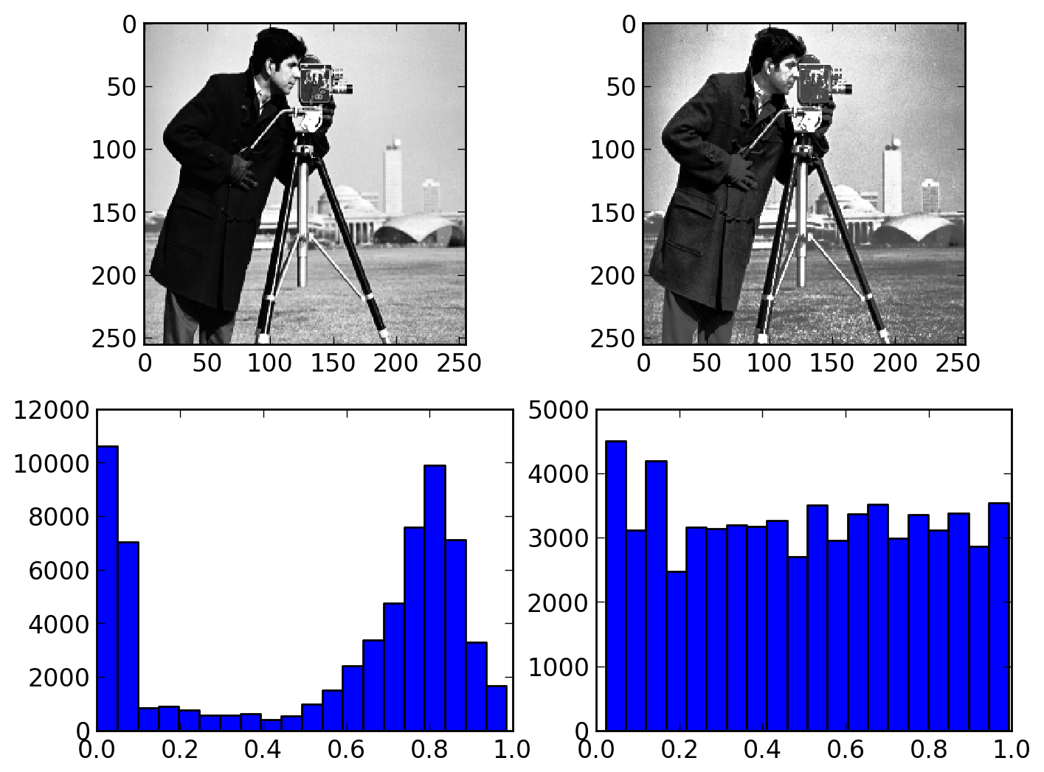
Histogram Eq

Slide 15

High Pass Filter
High pass filter is used to do the sharpening of the images to the grayscale images. Sharpening is used to get the fine details of the image highlighted. Also it is used for edge detection.
These filters sharpens images by creating a high contrast overlay that emphasis edge in the image ,so also we can say that enhanced image is the result of addition of original image and the scaled version of the line structure and edges in the image.
High pass filter is also used to retain the frequency information within the image.

Slide 16
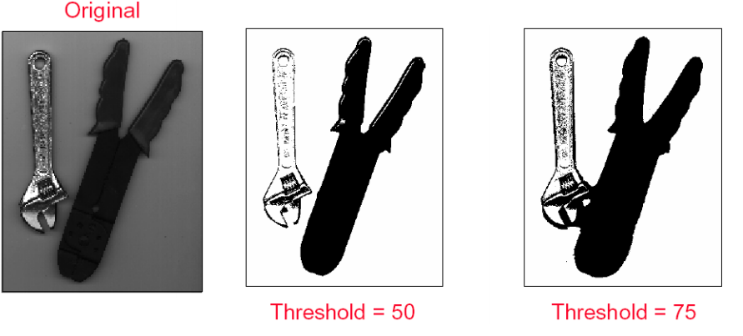
Threshold Segmentation
Segmentation is the process of partitioning the images into multiple segments.(set of pixels).
Image segmentation is typically used to locate the objects and boundaries(lines, curves) in the images also we can say assigning the label to each pixels in an image such that pixels share same label to view the visual characteristics.
Threshold method is based on the threshold value to turn a grayscale image into a binary image.

Slide 17
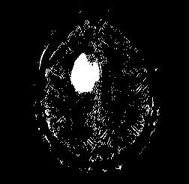
Threshold Segmentation
To make a binary image of the MRI
T = graythresh(c);
bw = im2bw(c,T+0.3);
imshow(bw);

Slide 18
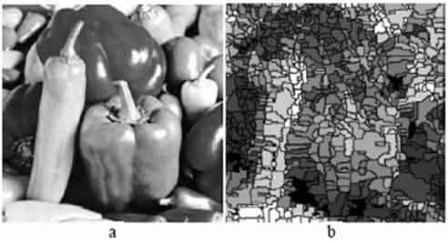
WATERSHED SEGMENTATION
The term watershed refers to a ridge that divides areas drained by different river systems. A catchment basin is the geographical area draining into a river or reservoir.
In short, a drop of water following the gradient of an image flows along a path to finally reach a local minimum. Intuitively, the watershed of a relief correspond to the limits of the adjacent catchment basins of the drops of water.

Slide 19
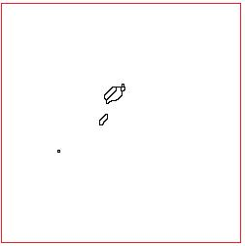
WATERSHED SEGMENTATION
To group pixels on the basis of their intensities.
bw5=watershed(bw1);
imshow(bw5);

Slide 20
Morphological operation
Morphology refers to the description of the properties of the shape and structure of the objects. Here binary images consists of various imperfections Thresholding are distorted by the noise and texture features.
Morphological operations are logical transformation based on the comparisons of the pixel neighborhood with a pattern.
These operations are usually performed on the binary images where the pixels values is between 0 and 1.

Slide 21
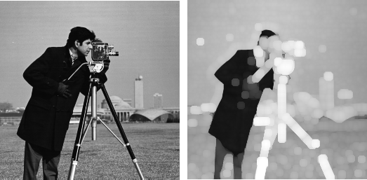
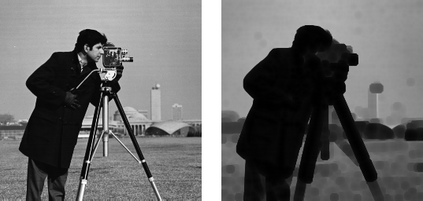

Morphological operation
Imdilate →
Imerode→
Sterl →

Slide 22
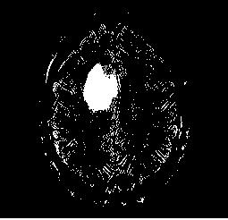
Morphological operation
Strel Mask
Imdilate Command
Imerode Command
SE = strel('disk',0);
bw1 = imerode(bw,SE);
imshow(bw1);
SE = strel('disk',0);
bw1 = imdilate(bw1,SE);
imshow(bw1);

Slide 23
Morphological operation
Morphological operations have proved very helpful in extraction and filtering techniques where operators like open, spur, dilate, erode and close have proved to be helpful in extracting the brain tumor from MRI brain images.
Image subtraction technique proved to be helpful along with threshold segmentation to work for the desired region of the image.

Slide 24
Image subtraction
Here in image subtraction operators takes two images as input and produce as output a third image ,whose pixels values are the values obtained by subtraction between the two images.
Here in this technique the tumor is extracted based on the closely packed pixels present in the image, by this tumor is removed.

Slide 25
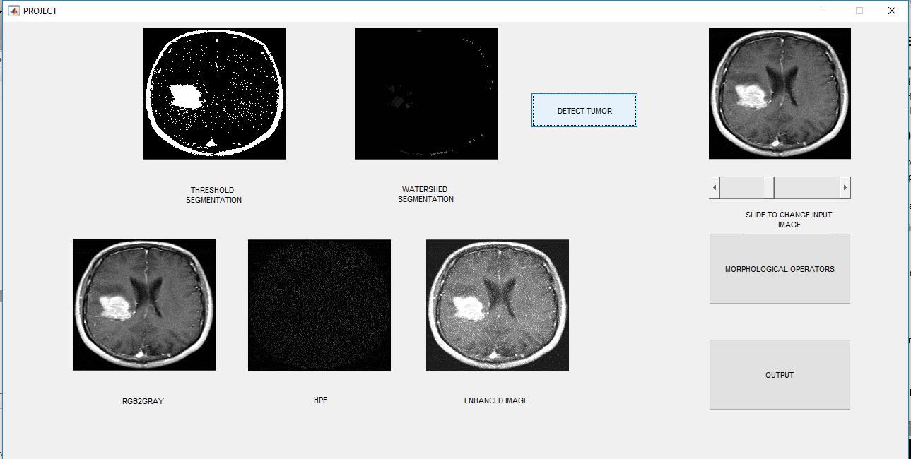
RESULTS

Slide 26
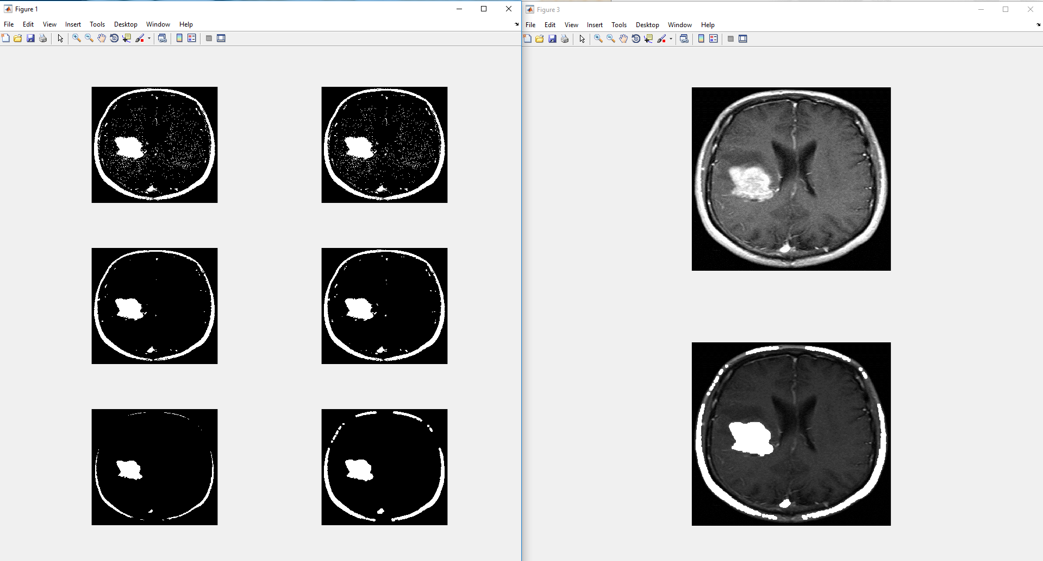

Slide 27
ADVANTAGES
Uses region-based left-right symmetry, rather than point- wise symmetry
Uses single MR image
No training data required
No image registration needed

Slide 28
CONCLUSION
The current method uses a computer aided system for brain MR image segmentation for detection of tumour location using bounding box symmetry.
The resulting method is very fast, robust and reliable for indexing tumour or edema images for both archival and retrieval purposes and it can use as a vehicle for further clinical investigations.

Slide 29
FUTURE SCOPE
In future, this technique can be developed to classify the tumours based on feature extraction.
This technique can be applied for ovarian, breast, lung, skin tumors.
Instead of rectangular boxes, can work with general boundaries: level set based framework.

Slide 30
THANK YOU

